Slide 1
University Campaign Marketing Insights and Visualization
Team 12

Slide 2
Presentation Structure
Introduction
Validation
Findings
Overview & Key Metrics
Campaign Types
Calls Over Time
Agent Performance
Region Distribution
Summary and Recommendations

Slide 3
Introduction
“The purpose of this presentation is to identify key trends in our outreach campaigns and to find ways to improve campaign success. In simple terms, we want to understand what makes a campaign successful, and how we can ensure more applicants get responses to their inquiries.” This presentation also contains the validation of the dashboard.”

Slide 4
Data Validation

Slide 5

Data Validation
Data Consistency Check
Data types & formats
Correlation between key identifiers
Completeness Verification
Finding missing values
Duplicate Detection
Finding duplicate entries
Business Rule Validation
Connected & disconnected calls matchs total calls
Campaign dates with valid timeframes

Slide 6
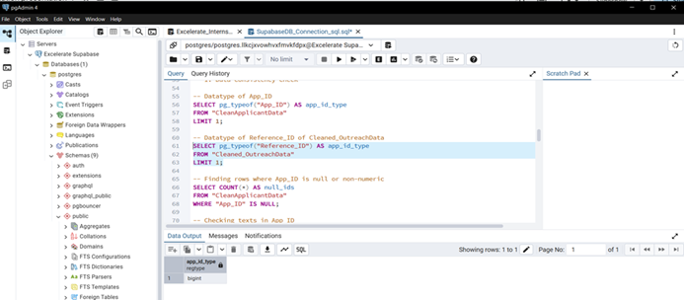
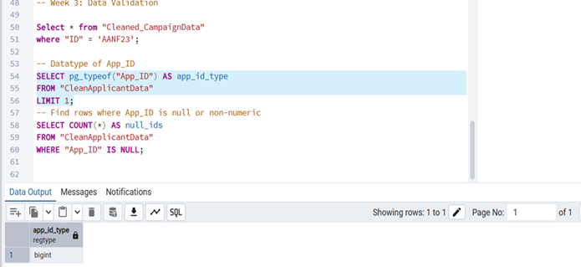
Data Consistency Check
Datatype of App_ID:
SELECT pg_typeof("App_ID") AS app_id_type
FROM "CleanApplicantData"
LIMIT 1;
Datatype of Reference_ID of Cleaned_OutreachData:
SELECT pg_typeof("Reference_ID") AS app_id_type
FROM "Cleaned_OutreachData"
LIMIT 1;

Slide 7
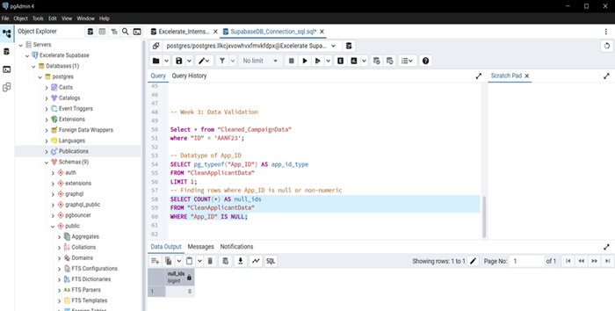
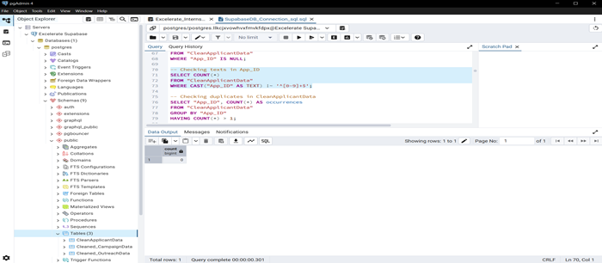
Data Consistency Check
Finding rows where App_ID is non-numeric:
SELECT COUNT(*) AS null_ids
FROM "CleanApplicantData"
WHERE "App_ID" IS NULL;
Checking texts in App_ID:
SELECT COUNT(*)
FROM "CleanApplicantData"
WHERE CAST("App_ID" AS TEXT) !~ '^[0-9]+$';

Slide 8
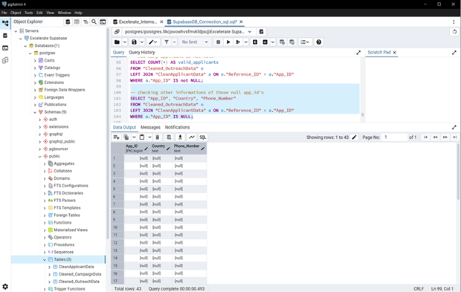
Data Consistency Check
How many applicant ID not null after joining:
SELECT COUNT(*) AS valid_applicants
FROM "Cleaned_OutreachData" o
LEFT JOIN "CleanApplicantData" a ON o."Reference_ID" = a."App_ID"
WHERE a."App_ID" IS not NULL;
Outreach Reference_ID should match ApplicantData.App_ID:
SELECT COUNT(*) AS missing_applicants
FROM "Cleaned_OutreachData" o
LEFT JOIN "CleanApplicantData" a ON o."Reference_ID" = a."App_ID"
WHERE a."App_ID" IS NULL;
So, those null App_ID’s also has null on country and other columns which shows it will not create any issue with other columns.

Slide 9
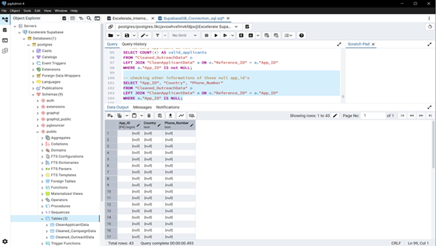
Data Consistency Check
checking other informations of those null app_id's:
SELECT "App_ID", "Country", "Phone_Number"
FROM "Cleaned_OutreachData" o
LEFT JOIN "CleanApplicantData" a ON o."Reference_ID" = a."App_ID"
WHERE a."App_ID" IS NULL;
1. Out of all outreach records, 42 records referenced invalid applicant IDs that did not exist in the Applicant dataset.
2. These represent ~0.1% of the total (42 / (33076+42)), which is statistically insignificant for overall trends.
3. For the current analysis and visualizations, these records were excluded to maintain data consistency.
4. Future work may involve:
1.Investigating why these IDs are missing (data entry error, system issue, external applicants).
2.Either removing them permanently or fixing them if correct references can be found.

Slide 10
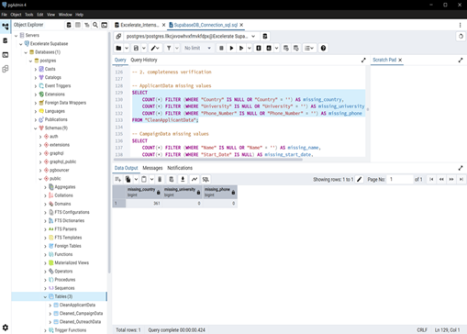
Completeness Verification
ApplicantData missing values:
SELECT
COUNT(*) FILTER (WHERE "Country" IS NULL OR "Country" = '') AS missing_country,
COUNT(*) FILTER (WHERE "University" IS NULL OR "University" = '') AS missing_university,
COUNT(*) FILTER (WHERE "Phone_Number" IS NULL OR "Phone_Number" = '') AS missing_phone
FROM "CleanApplicantData";
The Country column has 361 missing values, representing only 0.2% of the dataset. To account for this, a country filter was in the dashboard to ensure accurate analysis. added

Slide 11
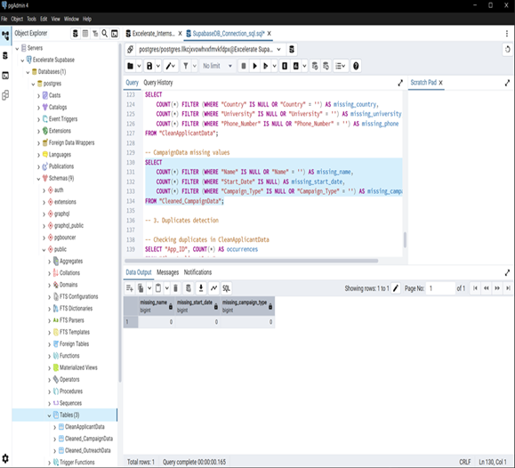
Completeness Verification
CampaignData missing values:
SELECT
COUNT(*) FILTER (WHERE "Name" IS NULL OR "Name" = '') AS missing_name,
COUNT(*) FILTER (WHERE "Start_Date" IS NULL) AS missing_start_date,
COUNT(*) FILTER (WHERE "Campaign_Type" IS NULL OR "Campaign_Type" = '') AS missing_campaign_type
FROM "Cleaned_CampaignData";

Slide 12
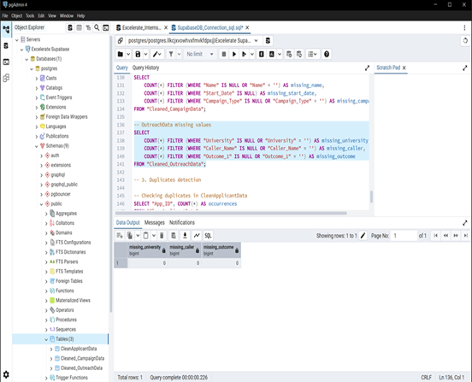
Completeness Verification
OutreachData missing values
SELECT
COUNT(*) FILTER (WHERE "University" IS NULL OR "University" = '') AS missing_university,
COUNT(*) FILTER (WHERE "Caller_Name" IS NULL OR "Caller_Name" = '') AS missing_caller,
COUNT(*) FILTER (WHERE "Outcome_1" IS NULL OR "Outcome_1" = '') AS missing_outcome
FROM "Cleaned_OutreachData";

Slide 13
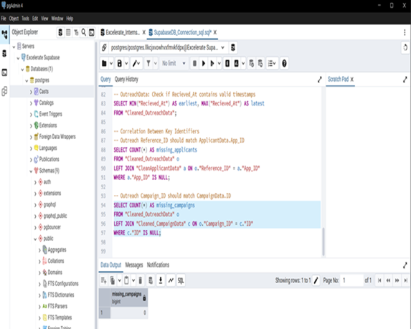
Completeness Verification
Outreach Campaign_ID should match CampaignData.ID:
SELECT COUNT(*) AS missing_campaigns
FROM "Cleaned_OutreachData" o
LEFT JOIN "Cleaned_CampaignData" c ON o."Campaign_ID" = c."ID"
WHERE c."ID" IS NULL;

Slide 14
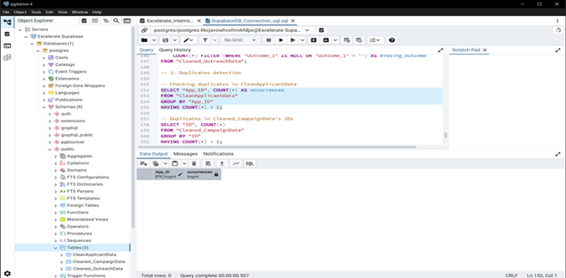
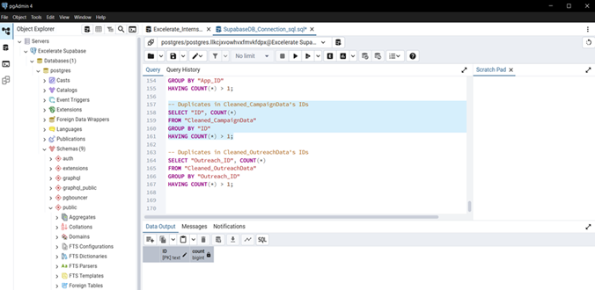
Duplicate Detection
Checking duplicates in CleanApplicantData:
SELECT "App_ID", COUNT(*) AS occurrences
FROM "CleanApplicantData"
GROUP BY "App_ID"
HAVING COUNT(*) > 1;
Duplicates in Cleaned_CampaignData's IDs:
SELECT "ID", COUNT(*)
FROM "Cleaned_CampaignData"
GROUP BY "ID"
HAVING COUNT(*) > 1;

Slide 15
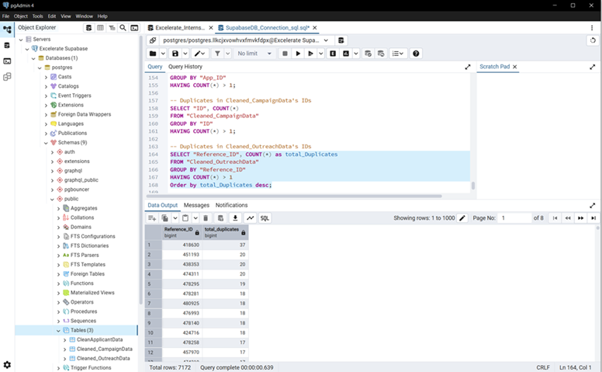
Duplicate Detection
Duplicates in Cleaned_OutreachData's IDs:
SELECT "Reference_ID", COUNT(*) as total_Duplicates
FROM "Cleaned_OutreachData"
GROUP BY "Reference_ID"
HAVING COUNT(*) > 1
Order by total_Duplicates desc;
Here, duplicates is must as “reference_Id” is foreign key.

Slide 16
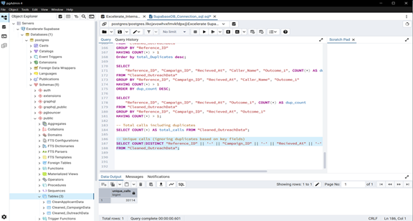
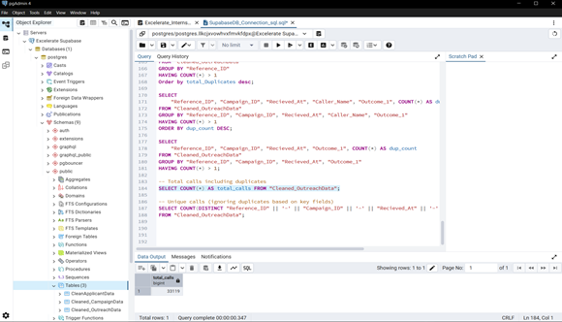
Duplicate Detection
Total calls including duplicates
SELECT COUNT(*) AS total_calls FROM "Cleaned_OutreachData";
Unique calls (ignoring duplicates based on key fields)
SELECT COUNT(DISTINCT "Reference_ID" || '-' || "Campaign_ID" || '-' ||
"Recieved_At" || '-' || "Outcome_1") AS unique_calls
FROM "Cleaned_OutreachData";
Total calls = 33119
Unique call = 33114
During data validation, we found 5 duplicate call records out of 33,119 total calls, representing approximately 0.015% of the dataset.
This minimal duplication has an insignificant impact on the overall analysis and visualizations. Therefore, these duplicates were not removed for the current analysis, but they can be cleaned in future iterations for complete data integrity.

Slide 17
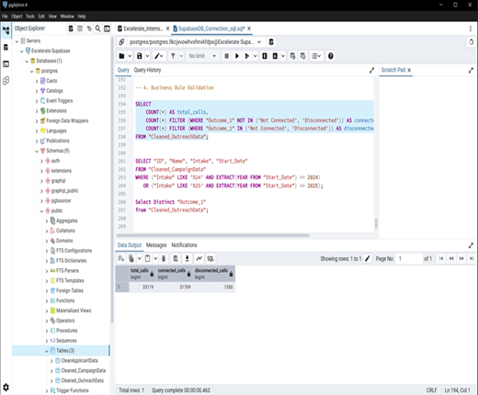
Business Rule Validation
Statistical Record of Total Calls:
SELECT
COUNT(*) AS total_calls,
COUNT(*) FILTER (WHERE "Outcome_1" NOT IN ('Not Connected', 'Disconnected')) AS connected_calls,
COUNT(*) FILTER (WHERE "Outcome_1" IN ('Not Connected', 'Disconnected')) AS disconnected_calls
FROM "Cleaned_OutreachData";
Here, Connected calls = 31769, Disconnected calls = 1350, and Total calls = 33119
For business rule validation, we classified all call outcomes as either Connected or Disconnected.
‘Not Connected’ and ‘Disconnected’ outcomes were grouped as Disconnected, while all other outcomes were considered Connected.
This allowed us to validate total calls against connected and disconnected counts for consistency

Slide 18
Business Rule Validation
Statistical Record of Total Calls:
SELECT
COUNT(*) AS total_calls,
COUNT(*) FILTER (WHERE "Outcome_1" NOT IN ('Not Connected', 'Disconnected')) AS connected_calls,
COUNT(*) FILTER (WHERE "Outcome_1" IN ('Not Connected', 'Disconnected')) AS disconnected_calls
FROM "Cleaned_OutreachData";
Here, Connected calls = 31769, Disconnected calls = 1350, and Total calls = 33119
For business rule validation, we classified all call outcomes as either Connected or Disconnected.
‘Not Connected’ and ‘Disconnected’ outcomes were grouped as Disconnected, while all other outcomes were considered Connected.
This allowed us to validate total calls against connected and disconnected counts for consistency

Slide 19
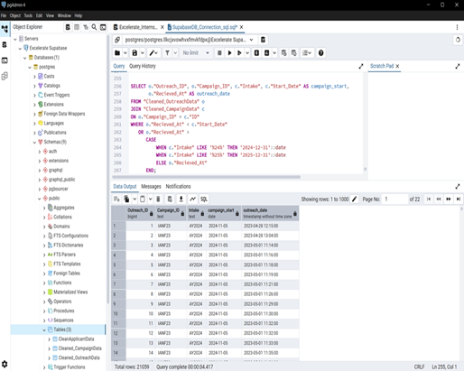
Business Rule Validation
Validation of Campaign and Outreach Timeframes:
SELECT o."Outreach_ID", o."Campaign_ID", c."Intake", c."Start_Date" AS campaign_start,
o."Recieved_At" AS outreach_date
FROM "Cleaned_OutreachData" o
JOIN "Cleaned_CampaignData" c
ON o."Campaign_ID" = c."ID"
WHERE o."Recieved_At" < c."Start_Date"
OR o."Recieved_At" >
CASE
WHEN c."Intake" LIKE '%24%' THEN '2024-12-31'::date
WHEN c."Intake" LIKE '%25%' THEN '2025-12-31'::date
ELSE o."Recieved_At"
END;
Campaigns for intakes FA24 and SP25 were planned for 2024 and 2025, respectively. Outreach and marketing activities began earlier, with some Start_Dates in 2023, which is consistent with standard marketing practice and does not indicate a data error. Business rule validation confirms that no campaign Start_Date exceeds its intake year range.

Slide 20
What we are trying to find?
Connectivity rate and general overlook of data
Distribution of call outcomes
Analyse agent
Region distribution
Recommendations to boost performance

Slide 21
Overview & Key Metrics

Slide 22
Summary of Data - KPIs
3
Campaigns
12
Agents
15,117
Applicants
29.86%
Connectivity Rate
33,119
Total Interactions
143
Countries
748
Required Escalation
Majority of the calls were disconnected. We will explore ways of reducing this.

Slide 23
Campaign Types

Slide 24
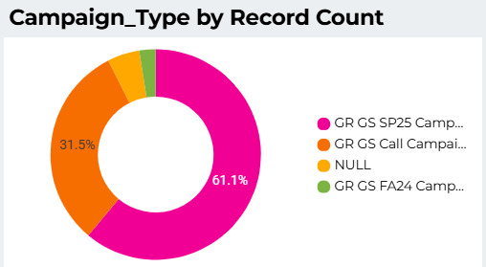
Overview of Campaign Volume
“The GR GS SP25 campaign accounted for most of the calls and was the most successful in attracting applicants. However, some calls were not attributed to any known campaign, which shows a gap in campaign tracking.”

Slide 25
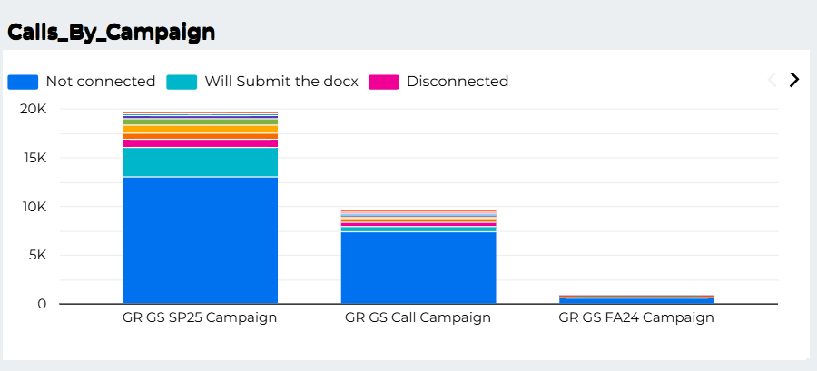
Call by Campaign
“Looking at call outcomes, we found that across all campaigns, the majority of calls were not connected. This highlights a major challenge in outreach effectiveness.”

Slide 26
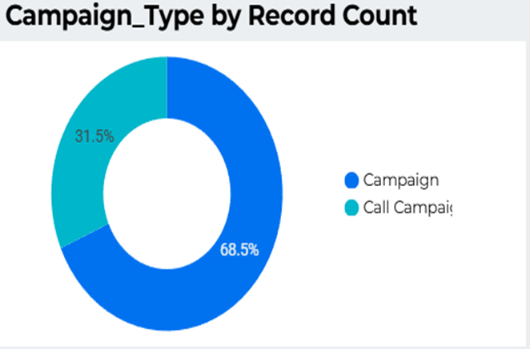
Campaign Type by Record Count
“When comparing campaign types, we see that Call Campaigns had about 31% of applicants, while Normal Campaigns had 69%. This indicates that applicants prefer engaging more during Normal Campaigns.”

Slide 27
Calls Over Time

Slide 28
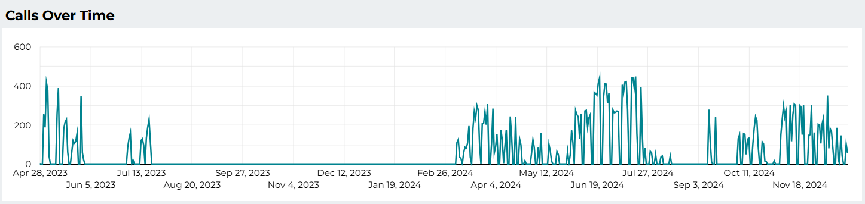
The spring season is the most season active.
Overall there is significant call activity in the months of February to July and from September to November.
The call activity correlates with the campaign dates.
Notes:
The trend here also shows that the spring season, is the most season active.
There is spike in activity in April 2023 and July 2023, and a similar trend is observed in 2024, but starting in February.
Between February and July 2024 there is significant call activity, although there is a slow down in the month of May.
Although less, there is also call activity in October and November. With a spike at the onset of September with the commencement of studies.
Call activity is strongly correlated to campaign dates, as it should be. Thus displaying the success of these campaigns.

Slide 29
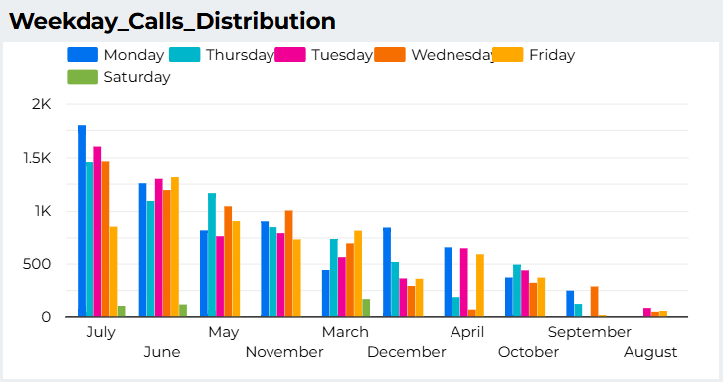
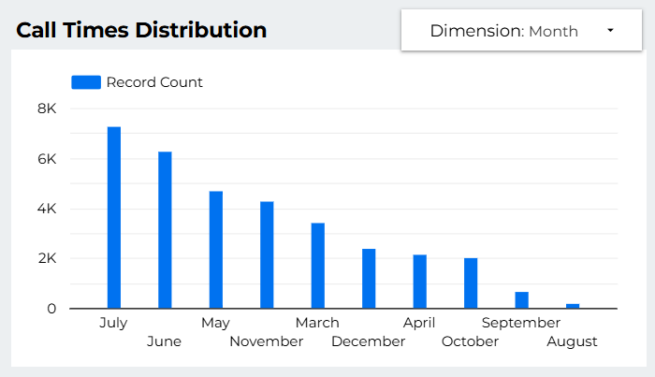
Weekday Calls Distribution
Call Times Distribution
Similarly this chart shows that June and July are the most active months in terms of calls. August has the least interactions.

Slide 30
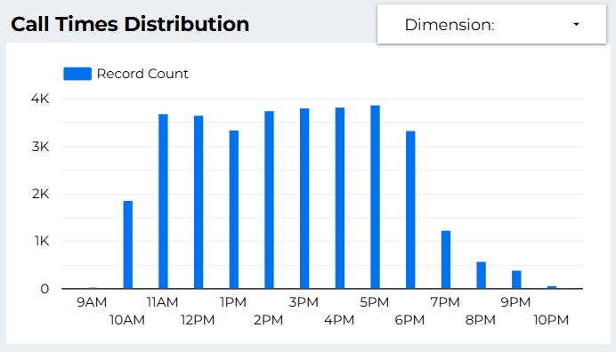
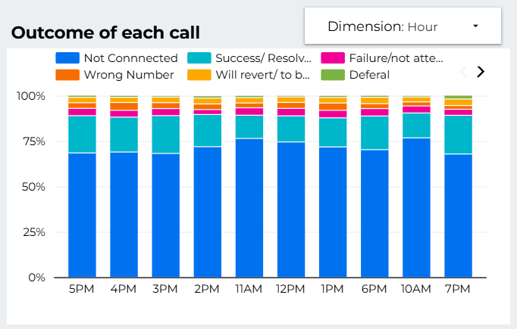
Call Times Distribution
Calls come in from 10 AM to 10PM.
Highest Call activity is between 11AM and 6PM.
The outcome distribution varies slightly over call hours. However more calls are unconnected between 10AM and 12 PM.

Slide 31
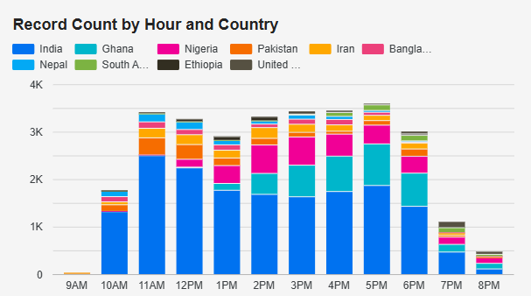
Call times by Country
This shows the variation in call activity per country for each hour.
Leaning into this trend can help agents optimize call hours for the various time zones to maximize call success.

Slide 32
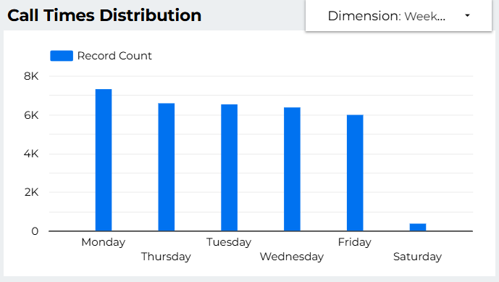
Daily call distribution
Weekdays have similar call activity, however Monday has the most.
Weekends have very little activity
Notes:
Saturday has very little activity

Slide 33
Agent Performance
Analyse agent performance by Call Volume, Connectivity rate and Success rate.

Slide 34
Overview of Method
In order to analyse call outcomes, the results were standardized by grouping them into a smaller number of categories:
Not Connected (Disconnected, voicemail, not connected)
Success/resolved
Failure/ not attending
Wrong Number
Will revert/to be solved
Deferral
Processing Visa
To evaluate agent performance, the tested interactive graph shows the distribution of call outcomes for each agent.
Success/resolved outcome includes an assurance of future university attendance, connectivity and resolved inquired .

Slide 35
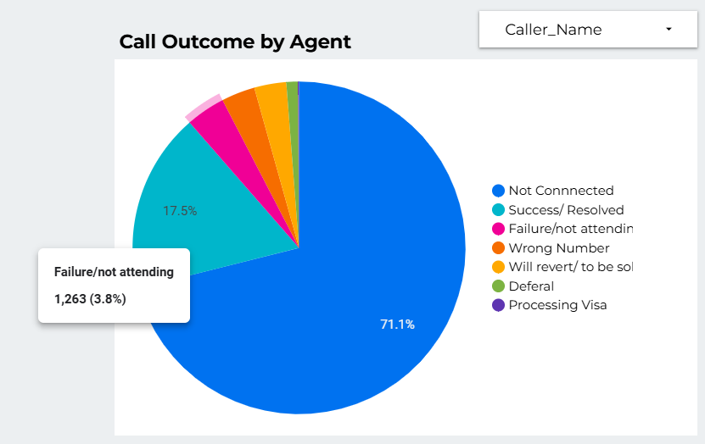
Overview of Call Outcomes
71.1% of calls were didn’t connected.
3.8% of calls were about inability to attend the university or loss of interest.

Slide 36
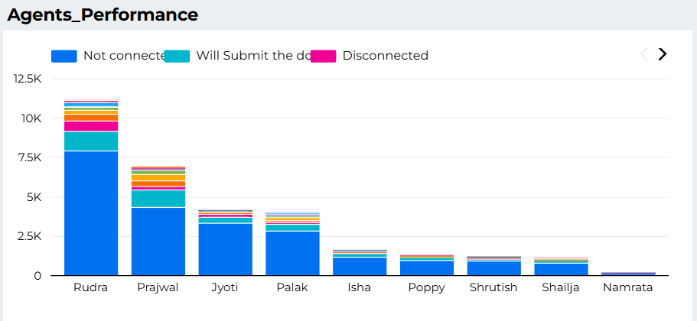
Agent Performance by volume of calls
Rudra serves the most calls while Namrata has the least.
Rudra had more positive communications with document submission

Slide 37
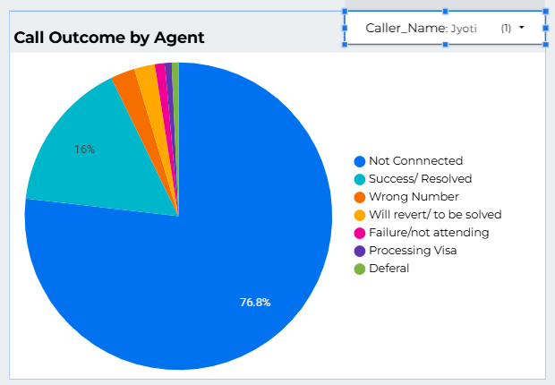
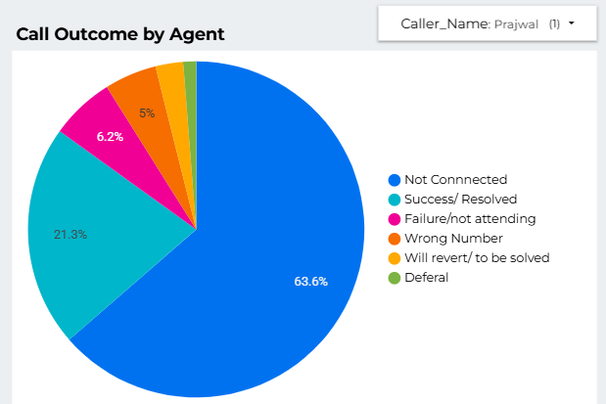
Agent performance by Proportion of Disconnected Calls
Among agents who serviced over 200 calls, Prajwal has the least percentage of unconnected calls, whiles Jyoti has the most proportion of unconnected calls.

Slide 38
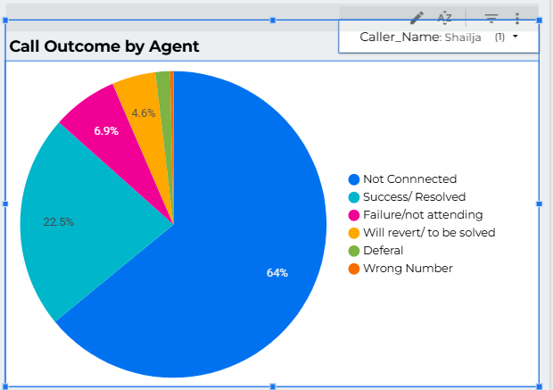
Agent Performance by Success rate
Shalija had the highest success rate for agents over 200 calls.
Also, had lowest proportion of wrong number + not connected outcomes.
Success is denoted by a assurance of future university attendance (and connectivity).
Notes:
We separated ‘wrong number’ from the general ‘not connected’ outcome in an effort to visualize the amount of resource, ie time, used up on inevitably unproductive outcomes, *beyond the control of the agent.

Slide 39
Region Distribution

Slide 40
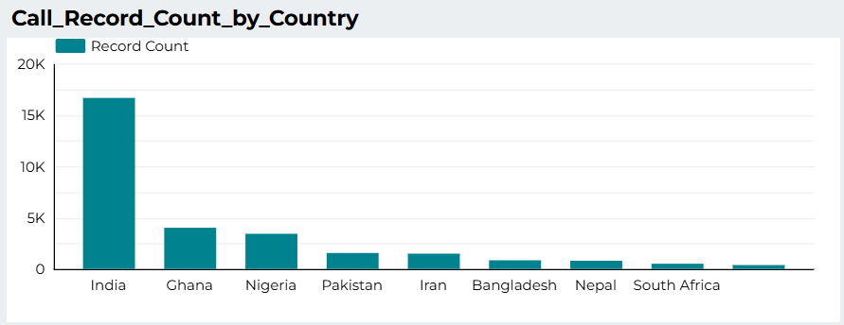
Country Distribution
India, Ghana and Nigeria had the highest number of applicants in Illinois Institute of Technology’s marketing campaigns
Agents should be well aware of the needs of students from these countries.

Slide 41
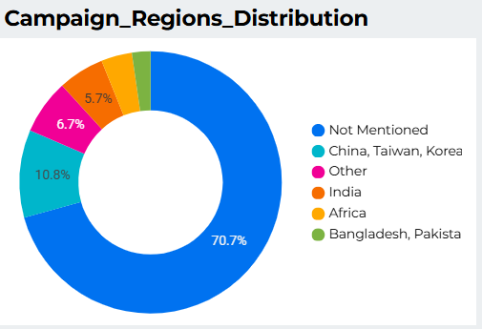
Campaign Regions
Normal campaign (70%) does not have region informations. And that is why more than 70% has “not mentioned” in region column.
On the other hand, 30% of the call campaign have region information which is why 11% (China, Taiwan, Korea), 7% other and 6% India are found where these campaigns were held.

Slide 42
Summary and Recommendations
We will look at the key takeaways, and explore recommendations to improve campaign success and data collection.

Slide 43
What are the key takeaways?
Only 29.86% of the calls were connected. While 70.14% failed.
GR GS SP25 generated the highest call volume.
31.5% of calls were not attributed to any campaign.
Spring period had highest monthly call volume.
The Fall period also has significant call activity.
Volume drops around May.
11AM to 6AM has the highest call volume in a day.
More calls are unconnected between 10AM and 12 PM.
Rudra handled the most calls. Namrata handled fewest calls.
Shalija had the highest success rate.
India accounted for majority of the calls

Slide 44
What are the key takeaways? – Validation
Findings
● June and July are the most busy period of the year in this marketing campaign.
● 42 outreach records had no matching applicant IDs (orphan records).
● Duplicate outreach entries inflated total calls by 5 records (0.01%).
● Connected + Disconnected calls = Total calls (business rule validated).
● Campaign Start_Dates began in 2023 for FA24 and 2024 for SP25, consistent with marketing practice.
● No campaign exceeded its intake year timeframe.

Slide 45
Recommendations
Improve connectivity rates
Adjust agent schedules & methods to account for peak hours with lower connectivity rates (10am to 12pm)
Enhance Campaign Tracking to reduce null or uncategorized calls.
Include categorizes for miscellaneous calls for further insight in the future.
More effort should be put in to ensure that the calls are accurately categorized. Also, if needed more categorizes should be included to capture the miscellaneous calls.
Agent performance management
Reward agents with high success rates to extend this outcome amongst more agents.
Optimize call timings for different countries.
Ensure agents are familiar with the needs of Indian, Ghanaian, Nigerian and Pakistan applicants.
More resources can be allocated to the spring season as it seems popular with applicant. It has a high ROI.

Slide 46
Recommendations to handle high volume seasons
The busiest times are May, June July, and November.
Part time workers can be hired to work during periods of high international demand. To maximize returns, part time workers’ ideal work days on Mondays, Tuesdays and Thursdays in June, July and November.
Specifically trained additional agents should be assigned to India and West Africa.
Also we can pivot working hours to meet varying international demand.

Slide 47
Recommendations to boost Performance
Provide bonuses or other commissions to agents which will improve productivity.
Continue early marketing since 2023 outreach supported 2024 intakes.
Focus campaigns in high-engagement regions for better ROI.
Engage more with Indian applicants as they are showing more interest.

Slide 48
Future Work
Address missing applicant data through better collection methods.
Remove duplicates before reporting to avoid inflated metrics.
Improve applicant linkage for outreach to reduce orphan records.
Removing data of those 43 Reference_ID’s which is connected with 43 null App_IDs.

